Slide 1
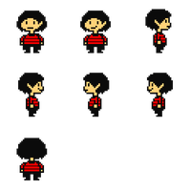
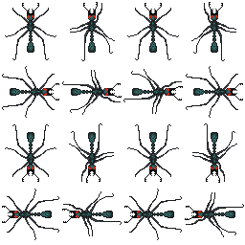
Field Day
By: Flying Squirrels
Cathy Huang and Jacqueline Frantellizzi

Slide 2

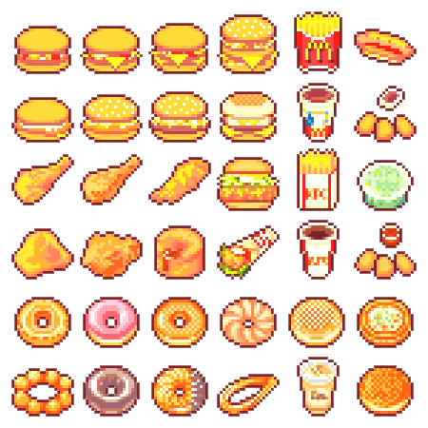
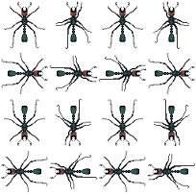
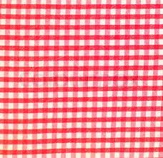


Slide 3


Slide 4
Don’t bump the rocks!
-1

Slide 5
Collect food
+10

Slide 6
Don’t miss the power ups!
+50

Slide 7
Get to the food before the human does
-20

Slide 8
Avoid human
Game
Over !

